Slide 1

Project title:
Machine Learning-Based Medication Prescription Support System
Name : Vasavi Boyina
Student ID: 23034883
Course: Data science
Module: Data science project
Supervisor: Gulay Gurkan

Slide 2
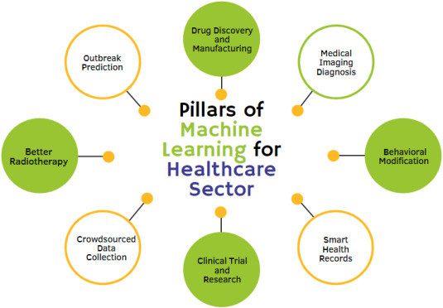
Introduction
Medication prescription is a critical aspect of healthcare, and the accuracy of these prescriptions can significantly impact patient outcomes. With the advent of data science and machine learning, there is a growing interest in developing systems that can assist healthcare professionals in making more informed prescription decisions. This project leverages a dataset from Kaggle to explore the effectiveness of different machine learning models in predicting medication recommendations.

Slide 3
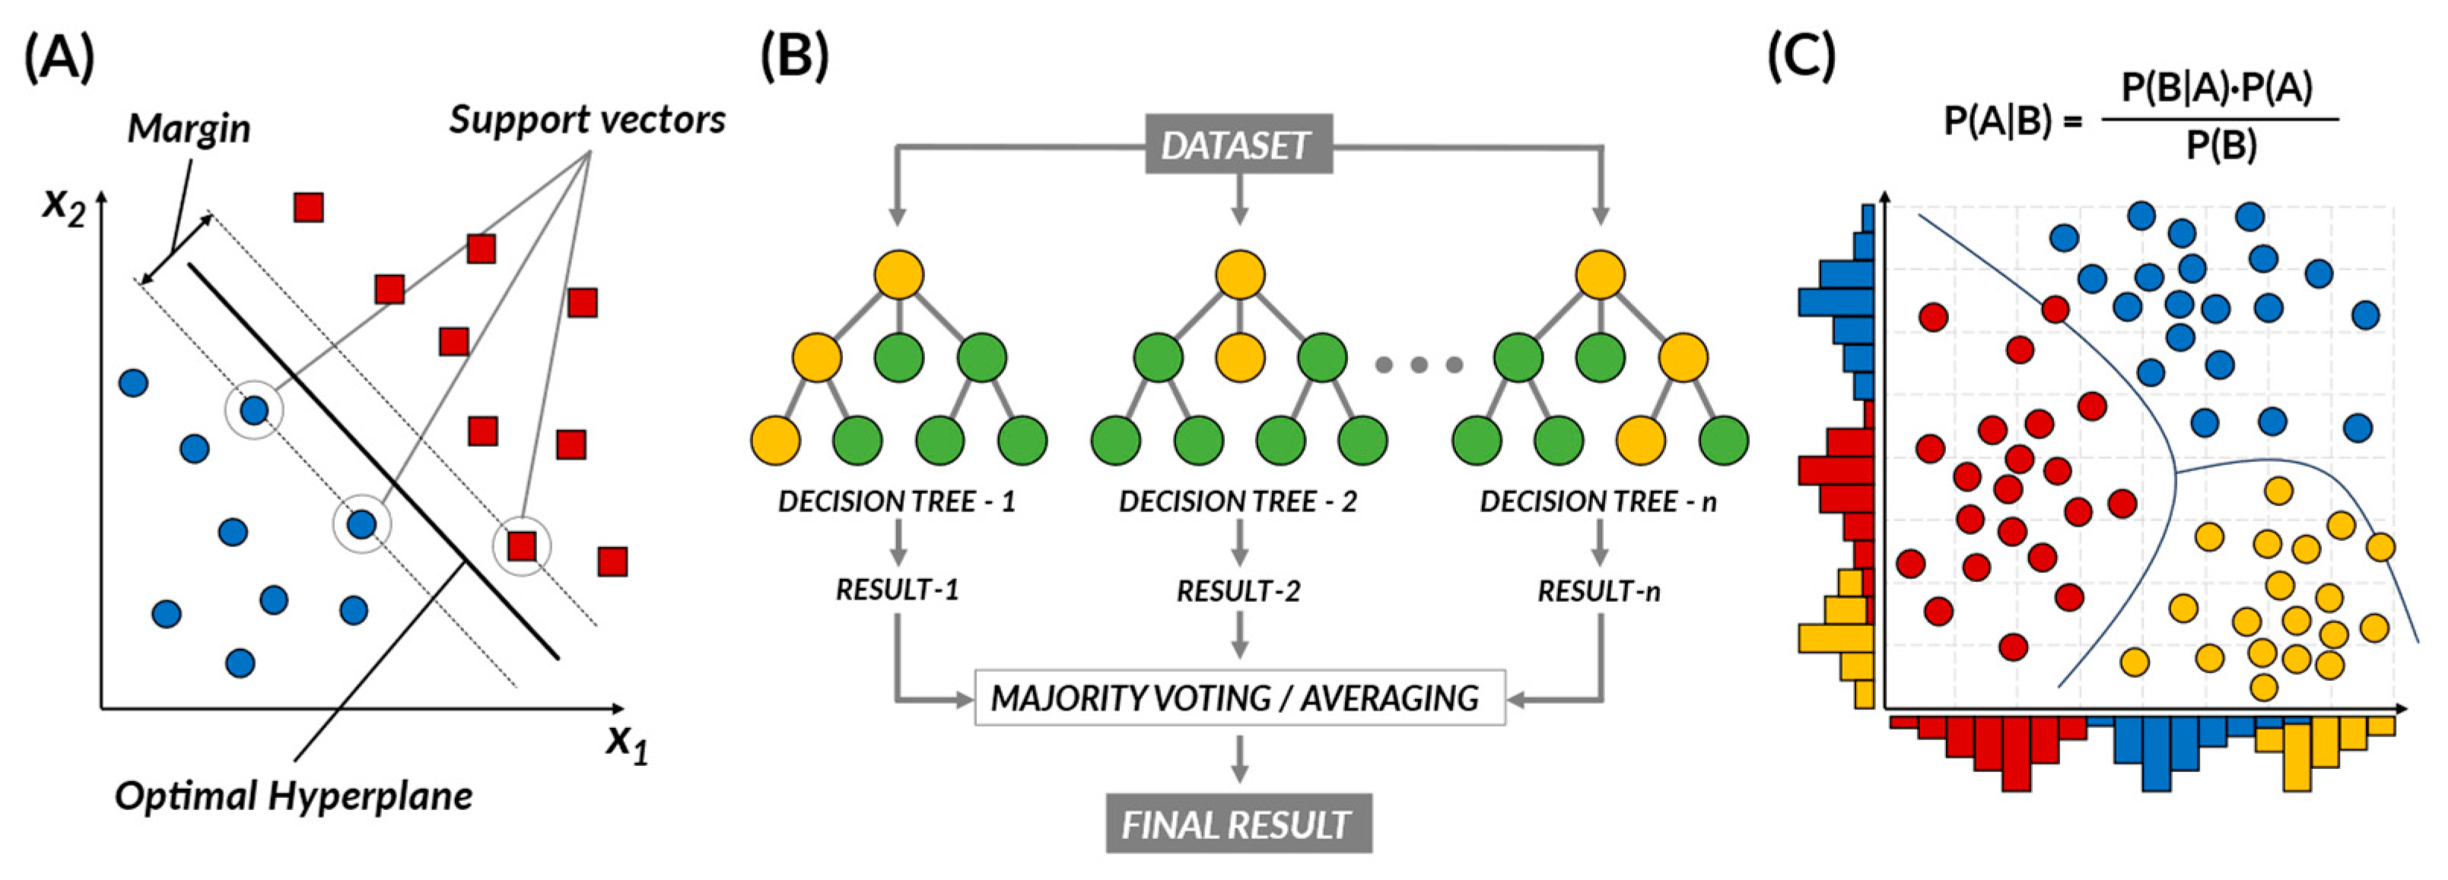
Problem Statement
Current medication prescription practices can be prone to errors due to the complexity of patient data and the vast array of available medications. Machine learning models have the potential to improve prescription accuracy by analyzing large datasets and identifying patterns that may not be immediately apparent to human practitioners. However, it is essential to determine which models are most effective and how they can be interpreted to ensure trust and adoption by healthcare professionals.

Slide 4


Research Questions
Which machine learning model performs best in terms of accuracy, precision, recall, and F1-score for medication recommendations?
How does the performance of ensemble methods compare to individual classifiers in predicting medication recommendations?
How interpretable are the results of each model, and which model provides the most transparent decision-making process for healthcare professionals?

Slide 5
Is that possible to achieve 100% Accuracy?
Yes, it is possible to achieve 100% accuracy in certain scenarios, particularly when working with highly consistent and well-defined medical datasets. For example, in cases like fever, where the treatment is universally standardized (e.g., paracetamol for everyone), the dataset can be perfectly accurate and predictable. Since the data is precise and the outcomes are deterministic, a model trained on such data can theoretically achieve 100% accuracy. However, this level of accuracy is highly dependent on the nature of the dataset and the problem being solved. In most real-world applications, especially in medicine, achieving 100% accuracy is rare due to variability in patient conditions, exceptions to rules, and the presence of noise or incomplete data. But in controlled, rule-based scenarios like the one you described, it is indeed achievable.

Slide 6
Dataset in-detailed
3.Disease-Diet Table
  Columns:
    Disease: The name of a medical condition.
    Diet: Recommended dietary guidelines or restrictions for managing the disease.
1.Symptom-Weight Table
  Columns:
    Symptom: The name or description of a symptom (e.g., fever, cough).
    weight: A numerical value representing the significance or severity of the symptom in diagnosing a disease.
2.Disease-Description Table
Columns:
  Disease: The name of a medical condition (e.g., Malaria, Diabetes).
  Description: A brief explanation or definition of the disease
5.Disease-Precautions Table
  Columns:
    Unnamed: 0: An index or unique identifier for each entry.
    Disease: The name of a medical condition.
    Precaution_1, Precaution_2, Precaution_3, Precaution_4: Four recommended precautions or preventive measures for the disease.
4.Disease-Medication Table
  Columns:
    Disease: The name of a medical condition.
    Medication: The standard treatment or medication prescribed for the disease (e.g., Paracetamol for fever).
6.Disease-Symptoms Table
  Columns:
    Unnamed: 0: An index or unique identifier for each entry.
    Disease: The name of a medical condition.
    Symptom_1, Symptom_2, Symptom_3, Symptom_4: Four common symptoms associated with the disease.

Slide 7
This dataset is designed for training machine learning models to predict diseases based on patient-reported symptoms. Each column represents a specific symptom, and the target variable (prognosis) indicates the predicted or diagnosed disease. The dataset is structured in a binary or categorical format, where symptoms are either present (1) or absent (0), and the prognosis column contains the disease name.
Training and Testing Dataset
Columns | Target Column
Symptom Columns: Each column represents a specific symptom (e.g., itching, skin_rash, joint_pain). The value 1 indicates the presence of the symptom, while 0 indicates its absence. There are 132 symptom columns in total. | Prognosis Column: A categorical column that represents the predicted or diagnosed disease (e.g., Malaria, Diabetes, Common Cold). This is my target variable.

Slide 8
Model Selection and Training
Decision Trees
Chakraborty, M. Rafiq, Y. H. Zarkob, Y. S. Chauhan and S. Sahay, "Ferroelectric FET-Based Bayesian Inference Engine for Disease Diagnosis," in IEEE Transactions on Circuits and Systems I: Regular Papers, doi: 10.1109/TCSI.2025.3533044.
Grari, V., Ruf, B., Lamprier, S. and Detyniecki, M., 2020. Achieving fairness with decision trees: An adversarial approach. Data Science and Engineering, 5(2), pp.99-110.
Random Forest
B. Moharana, V. K. Singh, T. Sarkar, A. Hassan and V. K. Pandey, "Predicting Indian Master's and PhD Enrollment using Data Mining & Machine Learning Approaches," 2024 4th International Conference on Technological Advancements in Computational Sciences (ICTACS), Tashkent, Uzbekistan, 2024, pp. 1714-1720, doi: 10.1109/ICTACS62700.2024.10841260.
Gradient Boosting
Tanveer, H., Adam, M.A., Khan, M.A., Ali, M.A. and Shakoor, A., 2023. Analysing the Performance and Efficiency of Machine Learning Algorithms, such as Deep Learning, Decision Trees, or Support Vector Machines, on Various Datasets and Applications. The Asian Bulletin of Big Data Management, 3(2), pp.126-136.

Slide 9
.
Support Vector Machines (SVM):K. S. Gill, G. Tuteja, V. Anand, R. Gupta and P. -A. Hsiung, "Water Quality Prediction using Classification techniques on XGBoost, KNeighbors, SVC, Random Forest, AdaBoost, and GaussianNB Classifier," 2023 Global Conference on Information Technologies and Communications (GCITC), Bangalore, India, 2023, pp. 1-4, doi: 10.1109/GCITC60406.2023.10426257.
Neural Networks
K. S. Gill, G. Tuteja, V. Anand, R. Gupta and P. -A. Hsiung, "Water Quality Prediction using Classification techniques on XGBoost, KNeighbors, SVC, Random Forest, AdaBoost, and GaussianNB Classifier," 2023 Global Conference on Information Technologies and Communications (GCITC), Bangalore, India, 2023, pp. 1-4, doi: 10.1109/GCITC60406.2023.10426257.
Model Training: Split the dataset into training and testing sets (70:30 ratio). Train each model on the training set and validate on the testing set.

Slide 10
Model Evaluation
Performance Metrics: I will use accuracy, precision, recall, and F1-score to evaluate model performance.
I will also perform some test cases to validate the accuracy and reliability of the model trained on this dataset. For example:
By running these test cases, I can verify if the model correctly predicts the disease based on the given symptoms. If the model’s output matches the expected prognosis, it confirms the model’s accuracy. If not, I will analyze the errors and refine the model further.
Interpretability: For interpretability I will Utilize techniques such as SHAP (SHapley Additive exPlanations) and LIME (Local Interpretable Model-agnostic Explanations) to assess model interpretability.

Slide 11

TimeLine- Gantt chart
Literature Review
Methodology Development
Experimentation & Implementation
Preliminary Results Analysis
Final Report Writing & Viva preparation
Feb-13 to Feb-25
Easy
(13-Days)
Feb-26 to march - 11
Medium
(14-Days)
March-12 to march 31
Critical Task
(20-Days)
Apr-1 to Apr-3
Medium
(3-days)
Apr-3 to Apr-9
Easy
(7-Daays)

